Slide 1
CLEANED – Virtual Training 22nd /06/2020 – 03rd /07/2020
Jessica Mukiri, An Notenbaert, Emmanuel Mwema, Birthe Paul, Rein Van der Hoek
cleaned@cgiar.org
CLEANED virtual training: 29/06/2020

Slide 2

Recap
Notes:
Show Agenda again

Slide 3
Present Assignment 3

Slide 4
Learning outcomes day 4
Breakdown the calculations used for output dimensions
Identify the key input and parameter data needed for calculations

Slide 5
Land dimensions
Notes:
How much land?
.What is the logic/ calculations?
What is the data input.
What are the parameters

Slide 6
Before land the feed basket?
We calculate how much land it would take feed the animals
We calculate the quality of the feed basket
Feed requirements of the animals
Then based on the quality how much in terms of Dry Matter would be needed to feed the animals
Then we go back to the feed basket and based on the % and allocation in wet and dry season we get the area of land

Slide 7
The quality of the feed-basket?
Quality is based on the feed items and their fractions in the total feed basket
Quality is meant to meet the animals' feed requirement

Slide 8
The livestock herd? How much feed do they need
Low productivity
High proportion used for maintenance

Slide 9
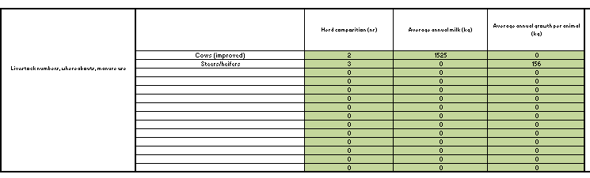
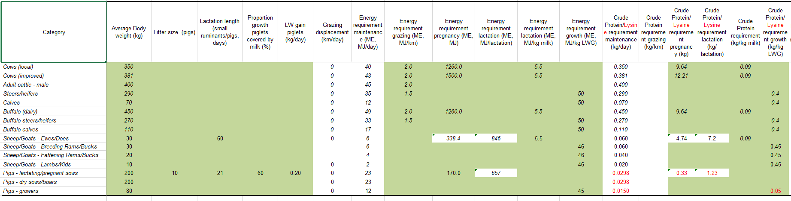
Feed requirement + Feed quality ==> feed amount Feed amount + crop yields ==> land size
X

Slide 10
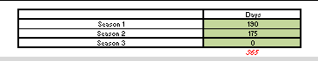
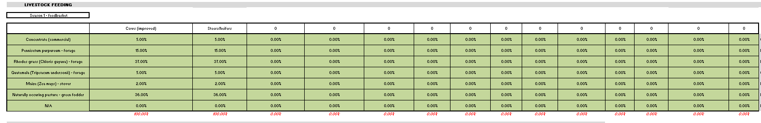
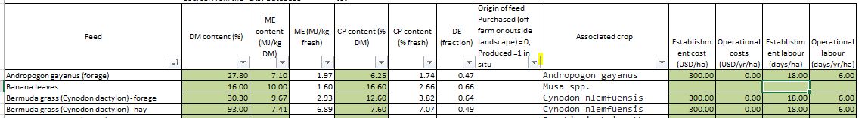
X
X

Slide 11
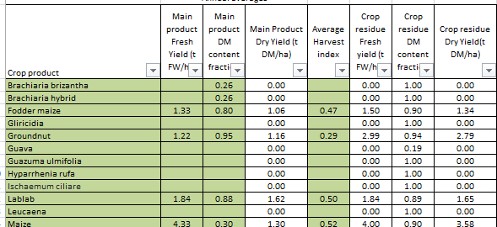
Feed Amount
X

Slide 12
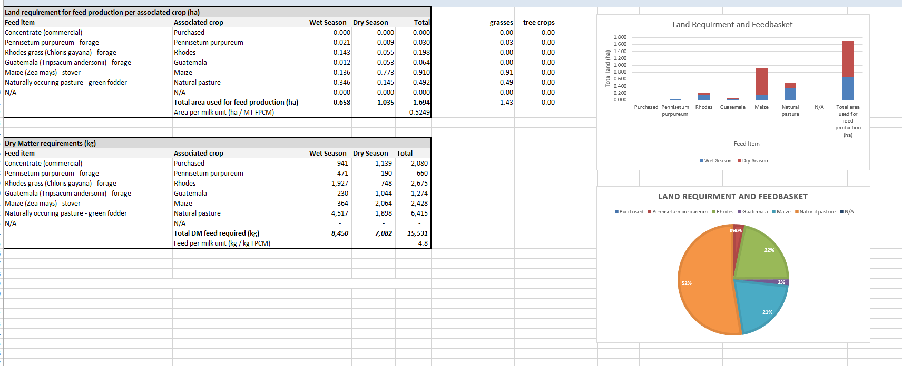
Land output as seen in CLEANED
Notes:
The results in ha/ also results have 3 seasons

Slide 13
Parameters needed
Crop Parameters
Feed Parameters
Livestock parameters

Slide 14
Quick look at the parameters

Slide 15
Livestock

Slide 16
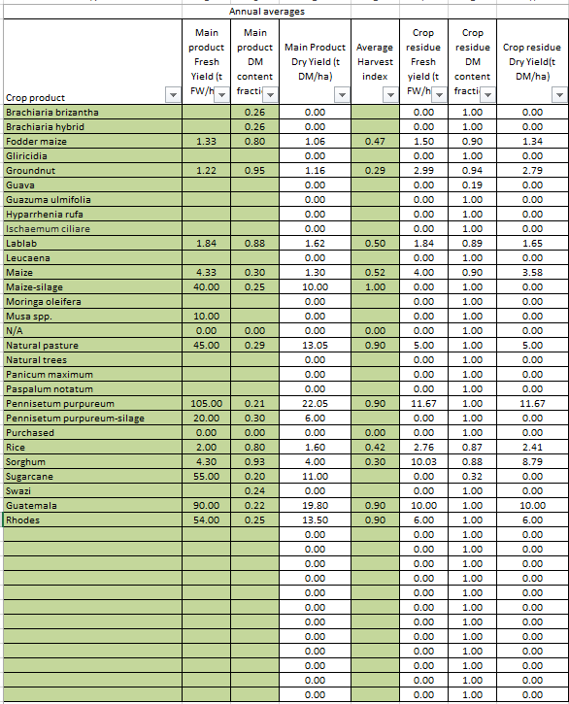
Crop

Slide 17
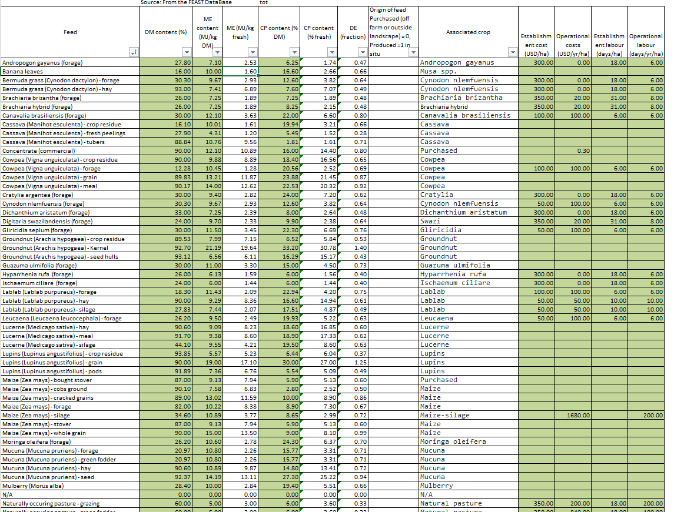
Feed

Slide 18
Productivity
Notes:
How much milk/meat/manure?
.What is the logic/ calculations?
What is the data input.
What are the parameters
It is alright to make assumptions, if you think yield is 1000 kg per year and you have put 800 then don’t worry. This is rapid and ex-ante and this means that it is close to reality but not perfect. We don’t need to know everything. There are so many variable that are not captured and the results are not truth

Slide 19
Production really a user input
Production based on the animal outputs
Milk
Meat
Manure
These are USER inputs based on local available data such as:
liveweight gain,
milk production per year
CLEANED will then calculate and give you productivity based on INPUT for a year and other indicators.

Slide 20
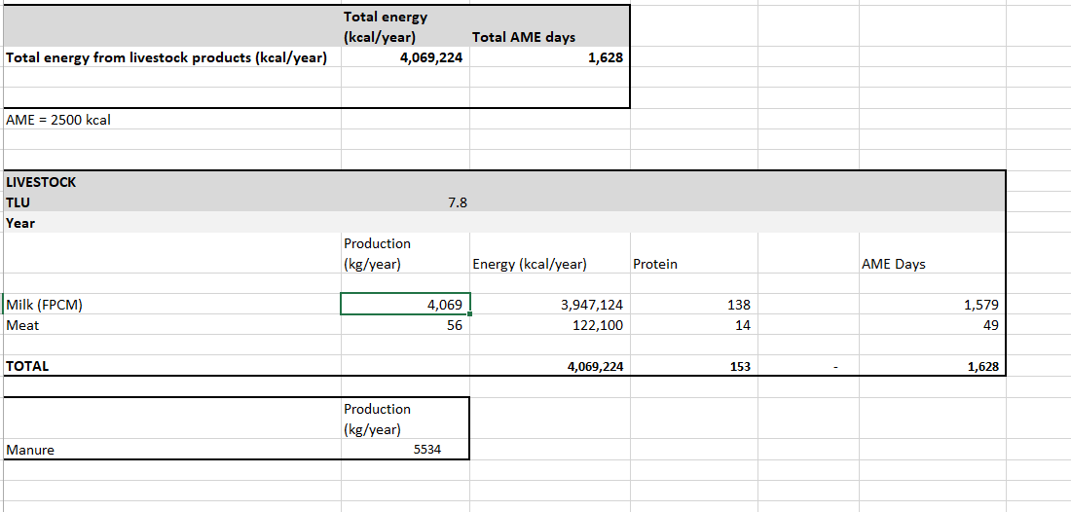
Looking back at Productivity results
Notes:
I'd also show the summary results for productivity; the list there is kind of neat + gives you the opportunity to talk about CLEANED reporting absolute values as well as relative (e.g. per hectare)

Slide 21

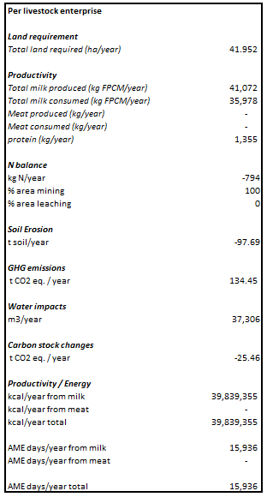
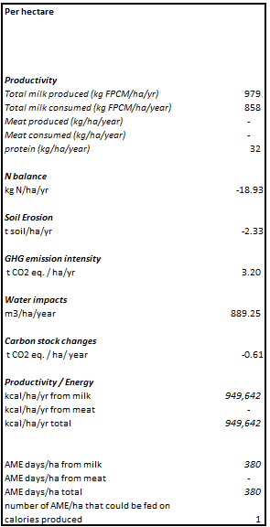
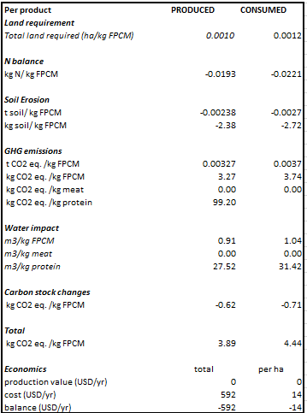
Summary
Notes:
Discuss the units in per livestock enterprise/Per hectare/Per product - Relative vs Asbolute values

Slide 22
Economics
Notes:
How much value for production?
.What is the logic/ calculations?
What is the data input.
What are the parameters

Slide 23
Simple Economics
Total Value of production: this calculation takes into account the total production, I.e. as if everything is sold.
Total production of meat, milk, manure is multiplied with the local sale price.
Prices are parameters

Slide 24
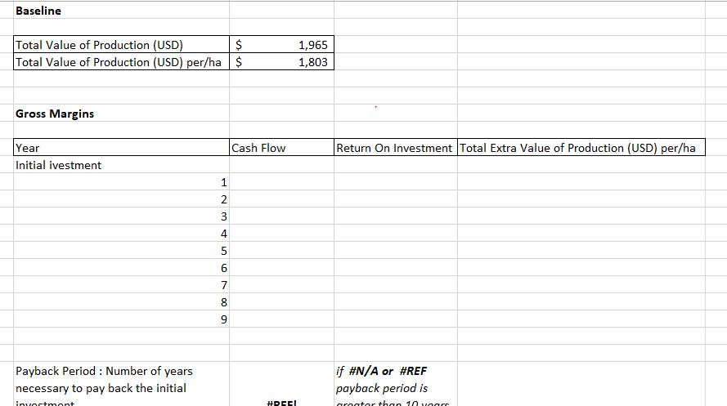

Slide 25
Assignment
Submit the CLEANED_V4_2 using the form below
Based on your dairy enterprise, change:
*One feed parameter (change the weight)
*One crop parameter (change the FW and fraction indicator

Slide 26
Pre-recorded material
To access the CLEANED workbook please see
link: https://cleanedtraining.netlify.app/
To go directly to day 4: https://cleanedtraining.netlify.app/paramters-calculations-for-impacts.html

Slide 27
Recap on what to do?
Quiz 4 : https://forms.office.com/Pages/ResponsePage.aspx?id=AA76ahT6t0CKLiKn-MNX1aE1vfzSBf5GkjzzKvqgj8ZUMzA4TDgwQTNSQzlCSFlYT0U3QUFBUVo1Ny4u
Assignement 4 :
https://form.jotform.com/201798299494071
Deadline for Assignment 4 is tomorrow 13:00hrs GMT.
You access Rein, Emmanuel and Jess using this email Cleaned@cgiar.org between 15:00Hrs - 17:00Hrs today and between 08:00hrs and 11:00Hrs tomorrow.
Looking forward to seeing you all again on Wednesday morning.

Slide 28
Thank you!

